Slide 1
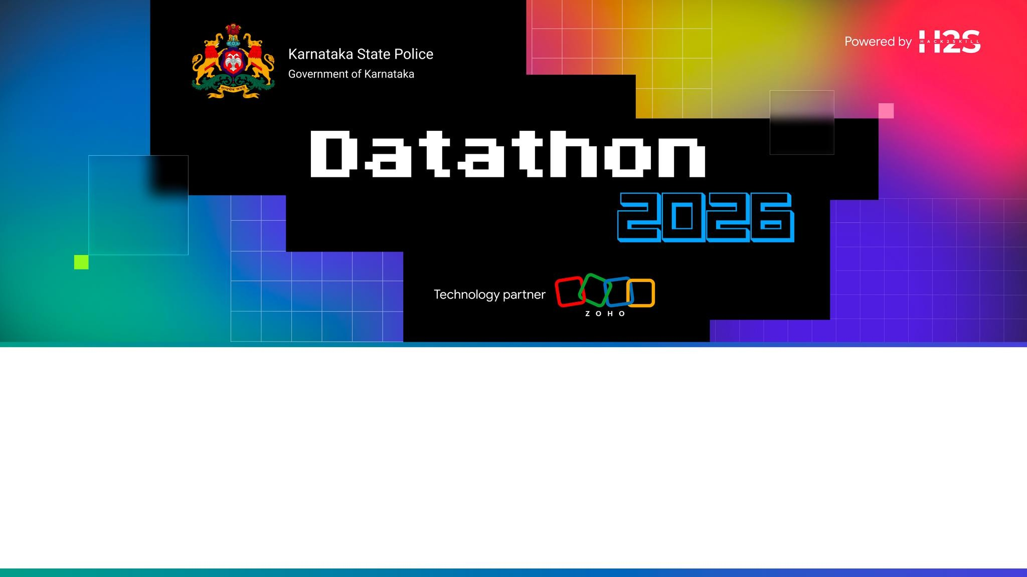
Team Details
Team name: My internet is Cooked
Team leader name: Bhakti Chand Tak
Team size: 4
Problem Statement: AI-Driven Crime Analytics & Visualization Platform

Slide 2
A verified data-to-dashboard pipeline for next-week crime intelligence
An end-to-end, leakage-aware AI platform that converts raw police FIR data into 1 week predictive crime intelligence, district-calibrated risk zones, repeat-offender tracking, cyber networks, and real-time scenario simulations all packaged in one portable, zero dependency dashboard.
80,000
Synthetic FIR Records Grounded in Karnataka
164
Police Stations across 31 Districts
1 week
Chronological Forecast Horizon
1 HTML
Portable, Embedded HTML Dashboard
Bullet Points
Dual-Engine Predictive Intelligence (Count & Serious Risk models)
District-Calibrated Hotspots (PAI + Voronoi boundaries)
Cyber & Financial Route Tracking (Repeat accused network graphs)
Socio-economic crime correlation (strict statistical governance)
Dynamic Scenario Simulator (Holidays, hours, day-types)
Trend alerts & anomaly detection

Slide 3
OPPORTUNITIES & SOLUTION DIFFERENTIATION
01
A. HOW DIFFERENT IS IT?
Unified 10-phase pipeline
Zero future leakage chronological split
Live "What-If" scenario simulations
02
B. HOW DOES IT SOLVE PROBLEM?
Actionable Station Classifications
Cross-Jurisdiction Cyber Crime Routing
Empirical Bayes Rate Stabilization
Different - Forecasting, spatial clusters, near-repeat context, fairness diagnostics and cyber routes are delivered together not as disconnected notebooks.
Useful - Station and district views translate model outputs into map-based operational awareness with
transparent thresholds and confidence context.
Defensible - Chronological validation, machine-readable sanity reports and explicit synthetic-data limits make every output reviewable
UNIQUE SELLING PROPOSITION (USP)
USP: Verified synthetic engineering + calibrated multi-head forecasting + bipartite cyber route tracking in a single deployable web artifact.

Slide 4
The feature set spans prediction, spatial context, cyber intelligence and auditability
Next-Week Crime Forecast
Poisson gradient boosting with chronological
evaluation.
Serious Offence Probability Calibrated classifier with a validation selected threshold.
District PAI (Predictive Accuracy Index) Risk Calibration
Prospective count thresholds selected by district.
DBSCAN (Trend Alerts ) & Near-Repeat Contagion
Recent DBSCAN clusters plus permutation-tested proximity signals (Haversine clusters + Knox decay).
Interactive Scenario Simulator Month, hour, holiday, day type and category controls.
Route-Capable Cyber Graph
Stable accused IDs linked to chronological station activity (Repeat offender station routes).
Descriptive Fairness Audit
Observed synthetic arrest-rate and attention-zone comparisons and Social economic co-relation Metro areas correlate higher with cyber, financial, and property crimes,
Automated Sanity Suite
Automated checks for coordinates, labels, networks and metrics.

Slide 5
The build flow moves from reproducible data to verified dashboard release
6-STAGE PIPELINE SEQUENCE
01
Generate Data
80K FIRs + 164
Station registry
02
Clean & Validate
Data Schema, Dates, Unique IDs,
Coordinates.
03
Forecast Engine
Count + Serious model Heads
04
Compute Context
Clusters, EB, PAI, Fairness, Cyber
05
Enrich
Profiles and Scenario Assumptions
06
Release
HTML,
Reports, sanity checks
Note
run_all.bat / run_all.sh to reproduces the complete sequence in one click.

Slide 6
4 - STEP OPERATOR JOURNEY
SET SCENARIO CONTEXT
Choose crime profile, holiday, day type, month and hour.
PROTOTYPE EXPERIENCE
One Interface,
Four Evidence Modes
MAP + SIMULATOR • TRENDS • CYBER ROUTES • AUDIT
Our Prototype :
Turns statewide signals into station level context
1
SCAN STATEWIDE MAP
Filter 164 Station markers by District and HOTSPOT ( WATCH / SAFE label) .
2
INSPECT STATION EVIDENCE
Open Station Forecast, Serious Probability, Uncertainty and Crime mix.
3
TRACE CYBER ROUTES
Focus an accused or station and map chronological Station - level activity.
4

Slide 7
ARCHITECTURE DIAGRAM OF THE PROPOSED SOLUTION
4-TIER ARCHITECTURE FLOW
DATA
ANALYTICS
PRESENTATION
RUNTIME
ksp_datagen_v8_final.py
ksp_pipeline_v8_final.py
scripts/build_release_da shboard.py
server.py / AppSail
Generates 80,000 synthetic FIR records (.csv.gz), station registry (164 stations), and data-gen sanity audits
Computes 27 leakage-aware features, trains two gradient boosting heads (Poisson count + calibrated serious classifier), and executes 9 analytical context phases
Standard library Python HTTP service hosting static dashboard files, health checks (api/health), and optional token-authenticated pipeline refresh (/api/pipeline/run)
Enriches JSON data with scenario profiles and embeds everything directly into a standalone index.html UI (Leaflet.js + Chart.js
+ Cytoscape.js).

Slide 8
The technology stack is deliberately small, open and reproducible
DATA & COMPUTATION
Python 3.11 · NumPy · Pandas · SciPy
MACHINE LEARNING
scikit-learn: Gradient boosting, Calibration, DBSCAN, BallTree
GEOSPATIAL + GRAPH
Shapely · NetworkX · Haversine distance · Station - area approximation
BROWSER EXPERIENCE
HTML · CSS · JavaScript · Leaflet · Chart.js · Cytoscape.js
PACKAGING & DELIVERY
JSON · gzip CSV · Docker · GitHub Actions · Zoho Catalyst AppSail

Slide 9
PRIMARY CATALYST SERVICE
ZOHO CATALYST SERVICES USED IN THE SOLUTION
Runtime variables
Configures X_ZOHO_CATALYST_LISTEN_PORT, HOST, ENABLE_
PIPELINE_RUN, and ADMIN_TOKEN via Catalyst AppSail console
Protected execution
Admin refresh endpoint (/api/pipeline/run) requires ENABLE_PIPELINE_
RUN=1 and X-Admin-Token or Bearer authentication
Atomic publication
Rebuilds occur under runtime/ before JSON and HTML are
replaced.
Future Catalyst services
Object storage, scheduled jobs and managed data services
are not required by V8.
USED NOW
AppSail
ZOHO CATALYST APPSAIL (USED NOW )
Docker-based Python microservice (server.py)
Static Dashboard + REST
Zero cloud DB dependencies

Slide 10
Prototype cost is low; production cost is driven by refresh frequency and governance
Prototype build | Low | Bundled data & outputs; static file serving
Hosted demonstration | Low | One containerized Catalyst AppSail instance
Operational pilot | Variable | Authoritative live data ingestion, Access Controls, Monitoring and Scheduled refresh.
Statewide production | Needs sizing | Statewide HA hosting, security & 24/7 SLA.

Slide 11
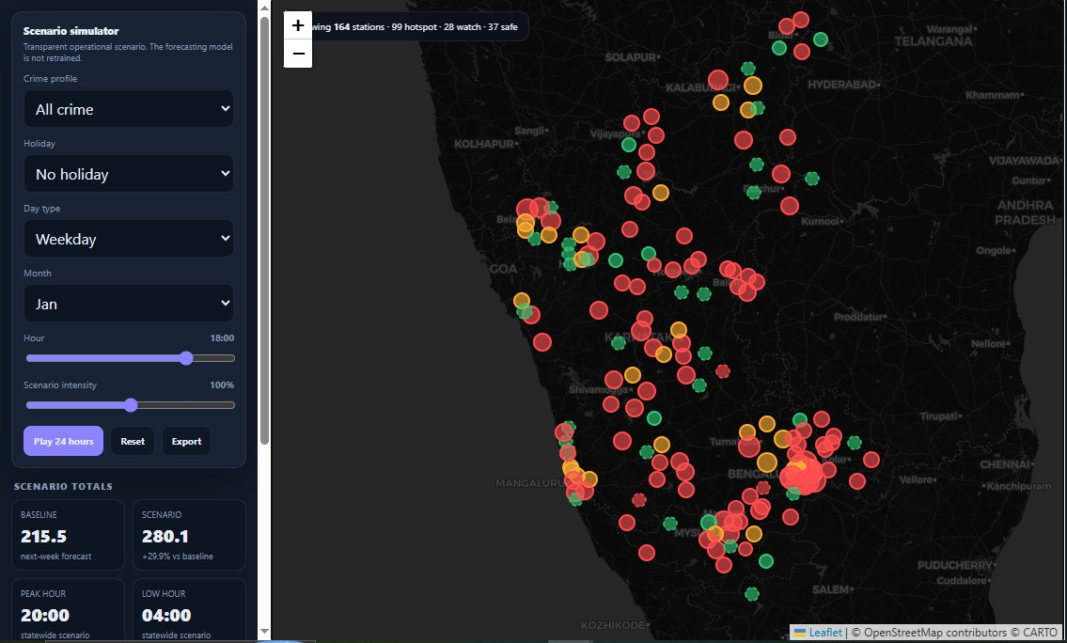
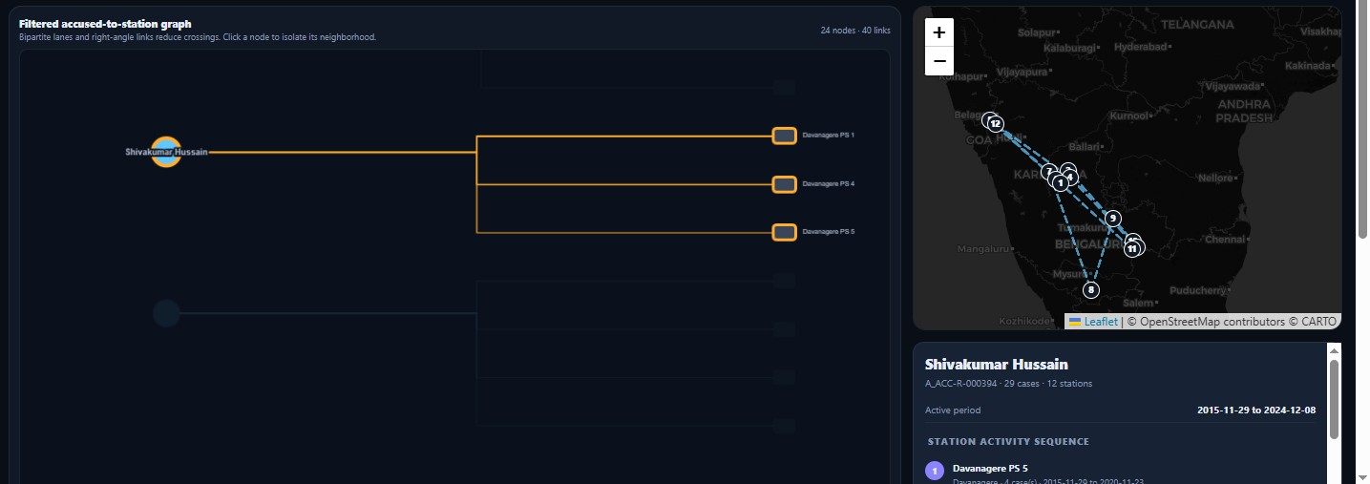
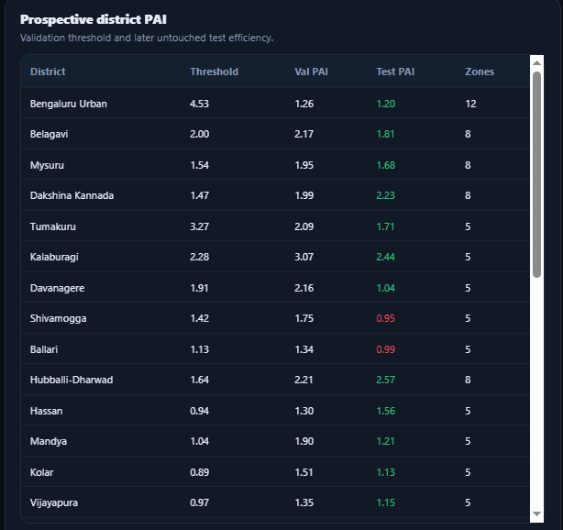
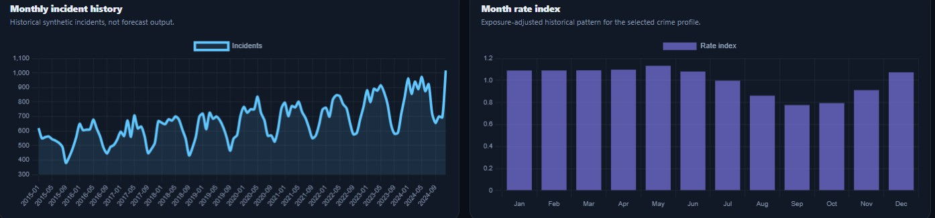
Snapshots of the prototype
MAP + SCENARIO SIMULATOR
FILTERED CYBER NETWORK + ROUTE MAP
DISTRICT WISE PREDICTIVE ACCURACY INDEX.
Trend Analysis :
Monthly incident history
Month Crime rate index
Weekday Crime rate index

Slide 12
Prototype Performance Benchmarking
COUNT FORECAST BENCHMARK (MAE)
SERIOUS RISK & PAI METRICS
Average Precision
0.489
Pipeline Model
0.8051
Seasonal baseline
0.8370
Serious ROC-AUC
0.707
Zero baseline
1.0694
AUDIT & NETWORK BENCHMARKS
FAIRNESS AUDIT CYBER NETWORK OPTIMIZATION
Median District PAI
1.319
1.40% arrest rate spread (9 groups)
0 audit warnings configured
76% visible node clutter reduction
119 repeat accused & 559 links

Slide 13
Submission links
01
GitHub public repository
https://github.com/bhaktictak/ksp-crime-intelligence
02
Demo video (3 minutes)
03
Deployed prototype
https://kspcrimeintelligence-50044296851.development.catalystappsail.in/

Slide 14
NOW
Harden Demo
FUTURE DEVELOPMENT: FROM SYNTHETIC VALIDATION TO GOVERNED OPERATIONAL EVIDENCE
PILOT
Authoritative Data
SCALE
Prove operational value
01
02
03
Automated CI/CD
Offline map caching
Signed release (checksums
(SHA256)
, • Accessibility (WCAG).
Official KSP GIS boundary
integration
Secure CAD pipelines
RBAC & Audit logging
Scheduled retrain
Prospective field evaluation,
Model drift monitoring,
Human review

Slide 15
RESPONSIBLE - DEPLOYMENT GUARDRAILS & GOVERNANCE
Decision support for synthetic engineering - NOT an automated enforcement system
SUPPORTED USES
NOT SUPPORTED
Reproduce & test pipeline code
Treat labels as dispatch orders
Benchmark vs. seasonal baselines
Claim legal fairness/causal bias
Explore "What-If" scenarios
Interpret routes as exact GPS
Review Spatial, Network and Fairness
Diagnostics
Deploy without official boundaries
Descriptive diagnostics based on 80k synthetic FIRs

Slide 16


